Slide 1



The F# Path to Relaxation
Language Design, Tools, Platforms, Community, Ecosystem, Exosystem, Openness, Cross-platform, …
Don Syme
F# Community Contributor and Principal Researcher, Microsoft Research

Slide 2
A Gentle Stroll Through the Land of Language Design and Delivery

Slide 3
A starting position…. The great disputes of computer science should be struggled with They are chances to make a better, simpler, more relaxed world as much as create opposing camps

Slide 4
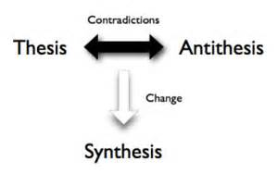
Not a new idea…

Slide 5
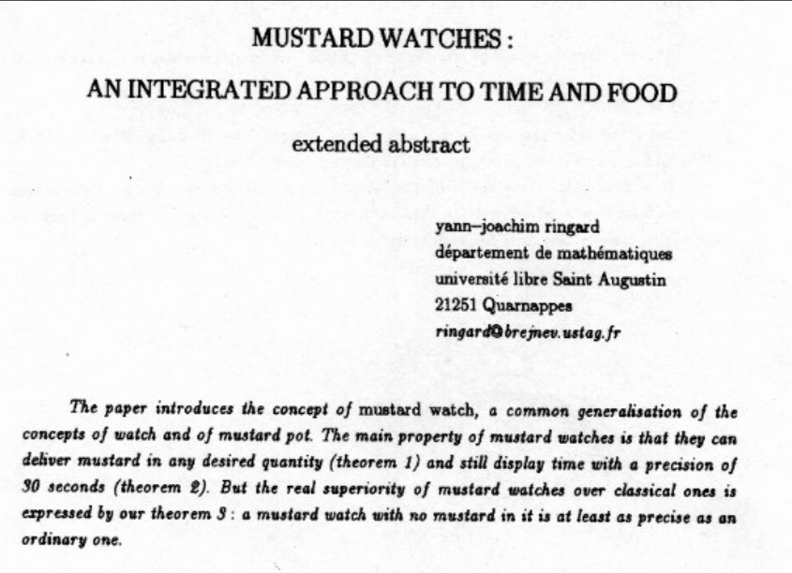
You can of course take this too far ☺

Slide 6
X
Y
?

Slide 7
Functional
Interop

Slide 8
Then (2003) Functional languages were isolated, non-interoperable, using their own VMs. Interop standards like C-calls, COM, CORBA, XML were a mess for language-integration.

Slide 9
And then things changed…

Slide 10
The F# Approach (also Scala, Swift, …) Embrace industry-standard runtime layers, and influence them. Keep exosystem at an appropriate distance. Design with end-to-end interop in mind. Compromise where needed.

Slide 11
Relaxation Achieved ☺ ✓Today’s FP languages are immensely interoperable while staying true to FP principles. ✓ F# type providers raise interop to a completely new level ✗Some tensions remain – not all functional techniques are easily implemented on industry standard VMs
Functional
Interop

Slide 12
X
Y
?

Slide 13
Enterprise
Openness

Slide 14
TL;DR – Where we are now
F# is open, cross-platform, independent
The F# Compiler Service powers many other tools
F# 4.0 is under way
Debian and other packages for Linux
The F# language is accepting contributions
The F# community is very “self-empowered”
fsharp.org
The Visual F# Tools are professional tools for Windows and Azure
Xamarin provide F# tools Android and iOS

Slide 15
The F# Language Design Process fslang.uservoice.com

Slide 16
The F# Compiler Service fsharp.github.io/FSharp.Compiler.Service

Slide 17
Relaxation Achieved ☺ Enterprise Quality + Openness + Community + Tooling + Ecosystem + Evolution Path = Goodness
Enterprise
Openness

Slide 18
X
Y
?

Slide 19
Functional
Objects

Slide 20
Then (2003) In the 1990s functional languages were historically anti-OO Even today any mention of objects gives some people an “urrgghhh…” reaction. Modern Compiler Implementation with Standard ML - Chapter 14, Object Oriented Programming object – to express a dislike or distaste for something (approx. quote)

Slide 21
F# - Objects + Functional
type Vector2D (dx:double, dy:double) =
let d2 = dx*dx+dy*dy
member v.DX = dx
member v.DY = dy
member v.Length = sqrt d2
member v.Scale(k) = Vector2D (dx*k, dy*k)
Inputs to object
construction
Object internals
Exported properties
Exported method

Slide 22
Objects
Constructed Class Types
type ObjectType(args) =
let internalValue = expr
let internalFunction args = expr
let mutable internalState = expr
member x.Prop1 = expr
member x.Meth2 args = expr
Object Expressions
{ new IObject with
member x.Prop1 = expr
member x.Meth1 args = expr }
{ new Object() with
member x.Prop1 = expr
interface IObject with
member x.Meth1 args = expr
interface IWidget with
member x.Meth1 args = expr }
Object Interface Types
type IObject =
interface ISimpleObject
abstract Prop1 : type
abstract Meth2 : type -> type

Slide 23
The F# approach is to embrace objects, make them fit with the expression-oriented typed functional paradigm especially for interop and software engineering purposes but not embrace full “object-orientation”

Slide 24
Functional
 | Expression-oriented | No null | Multiple Args = Tuples | Closure and Capture | First-class Values | Currying | HM Type Inference
void (unit) | ✓ | ✓ | ✓ | ✓ | ✓ | ✓ | ✓
Object Types | ✓ | ✓ | ✓ | ✓ | ✓ | ✓ | ✓
Subtyping | ✓ | ✓ | ✓ | ✓ | ✓ | ✓ | ✓
Dot-notation | ✓ | ✓ | ✓ | ✓ | ✓ | ✓ | ¾
Inheritance | ✓ | ✓ | ✓ | ✓ | ✓ | ✓ | ¾
Method Overloding | ✓ | ✓ | ✓ | ✓ | ¾ | ✗ | ¾
Objects
Relatively Graceful Degradation
(some type annotations needed)
Relatively Graceful Degradation
(some type annotations needed)
Some combinations outlawed for sanity

Slide 25
A functional-first approach makes a huge difference in practice fsharp.org/testimonials

Slide 26
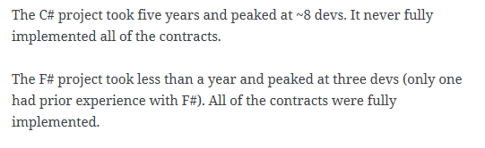
An analysis (Simon Cousins, Energy Sector)
350,000
lines of C# OO
by offshore team
30,000
lines of robust F#, with
parallel +more features
An application to evaluate the revenue due from Balancing Services contracts in the UK energy industry
http://simontcousins.azurewebsites.net/does-the-language-you-use-make-a-difference-revisited/

Slide 27
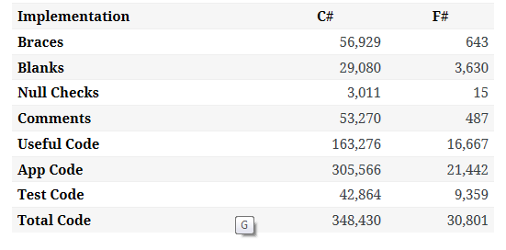

Slide 28
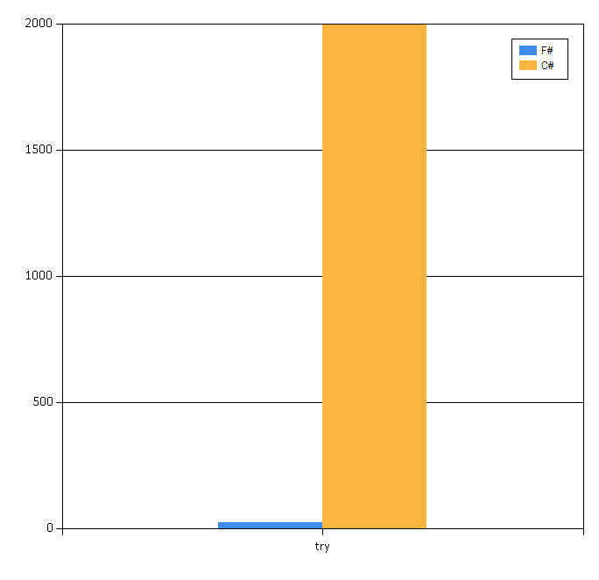

Slide 29
Simon Cousins, Energy Sector
Zero
bugs in deployed system
“Functional-first is the safe choice for this project,
any other choice is too risky”
An application to evaluate the revenue due from Balancing Services contracts in the UK energy industry
http://simontcousins.azurewebsites.net/does-the-language-you-use-make-a-difference-revisited/

Slide 30
Positive Synthesis Achieved some limitations remain… and there is one area in particular that’s worth discussing….
Functional
Objects

Slide 31
Circularities and Modularity in the Wild (Analysis by Scott Wlaschin)

Slide 32
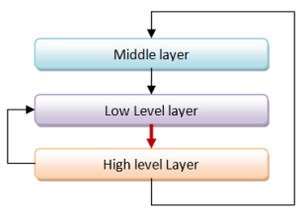
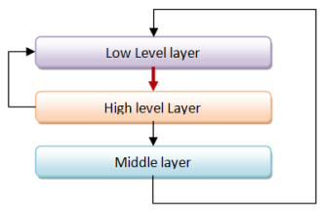
Unnecessary Circularities are Evil
To the functional programmer, it is “obvious” that our software methodology should help minimize and reduce cyclic dependencies in program structure.

Slide 33
The C# approach to circularity
All files in an “assembly” are mutually referential
[InternalsVisibleTo] can reveal internals of one assembly to another
Mutually recursive “assemblies” are possible if you try hard

Slide 34
The F# approach to circularity
Like all Hindley-Milner languages, F# has a file ordering
F# prohibits direct circularities across files
F# encourages minimizing dependencies within a file
Parameterization the preferred technique
F# objects support limited forms of circularity when needed

Slide 35
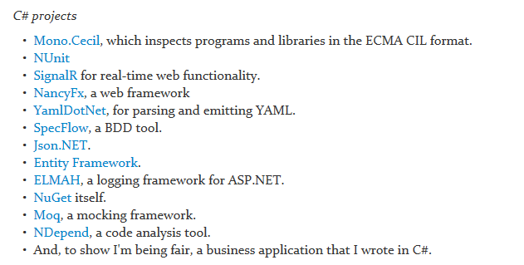
Let’s analyse some C# and F# projects

Slide 36
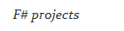
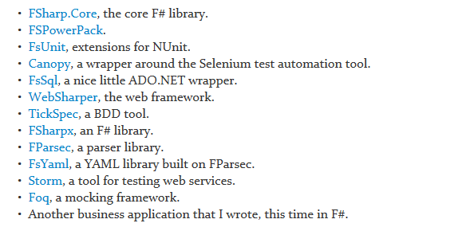
Let’s analyse some C# and F# projects

Slide 37
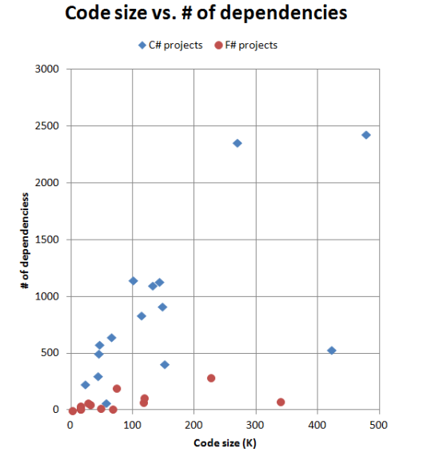
F# code has fewer top-level dependencies

Slide 38
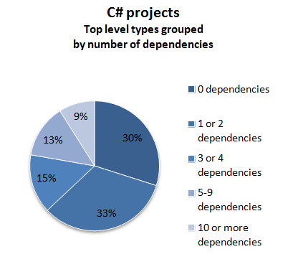
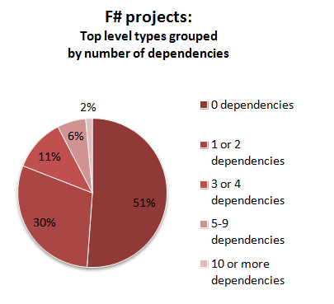

Slide 39
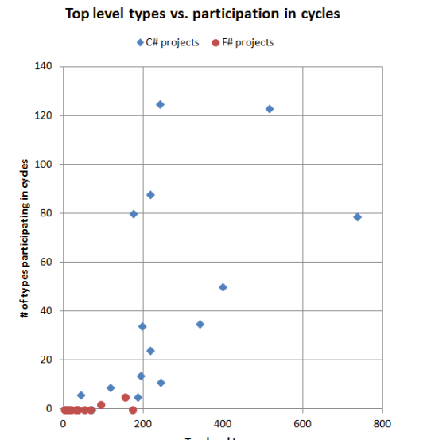
Why the difference between C# and F#?
In C#, there is nothing stopping you from creating cycles. In fact, you have to make a special effort to avoid them.
In F#, you can't easily create cycles at all.

Slide 40
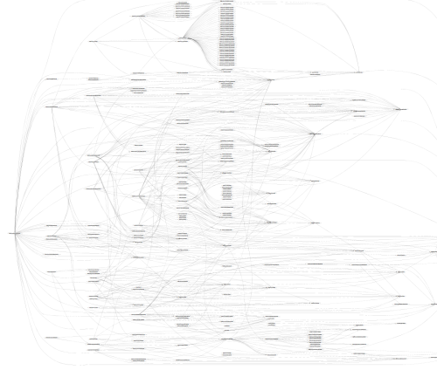
SpecFlow (C#)

Slide 41
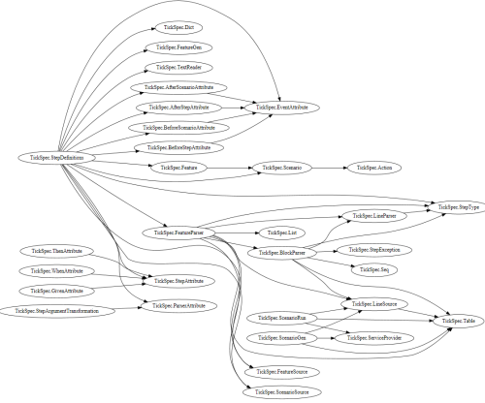
TickFlow (F#)

Slide 42
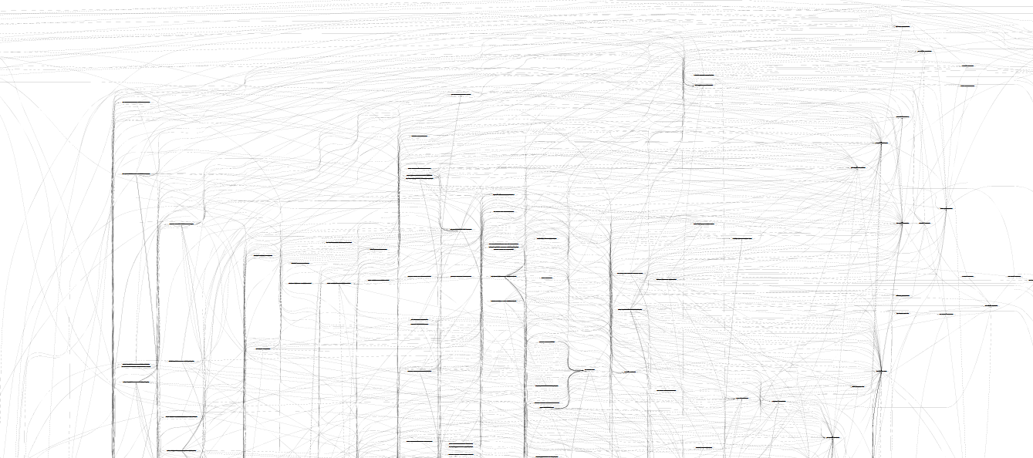
Microsoft Entity Framework
TickFlow

Slide 43
In theory and in practice, unmoderated intra-component cycles are a disaster Language mechanisms that enforce acyclicity are good There are significant unresolved tensions here in the major industrial languages

Slide 44
X
Y
?

Slide 45
Code
Data
In one large company, ~1000 people work on tooling for this
…and 5000+ people work on tooling for this

Slide 46
We are living through an information revolution

Slide 47
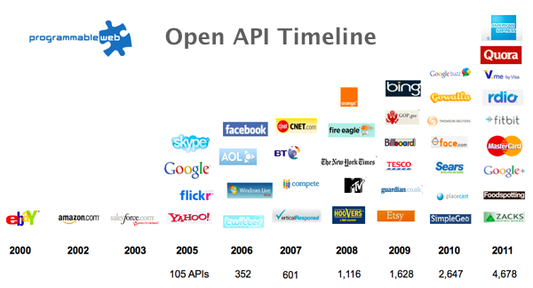
The Information Revolution
2012
2013
6,432
10,537

Slide 48
We need to bring information into the language… At internet-scale, strongly tooled, strongly typed

Slide 49
F# Type Providers = Compile-time meta-programming for scalable, on-demand injection of metadata as types

Slide 50
Many Data Sources, One Mechanism

Slide 51

All your types are belong to us….
Segoe UI Light
types

Slide 52
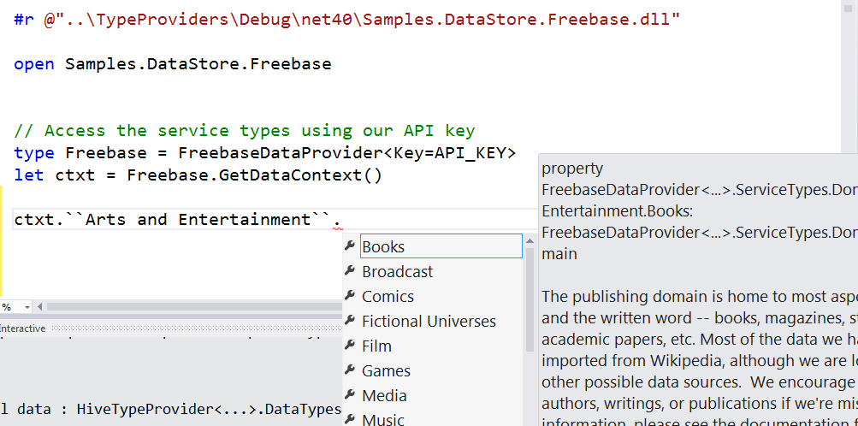
Entity Graphs

Slide 53
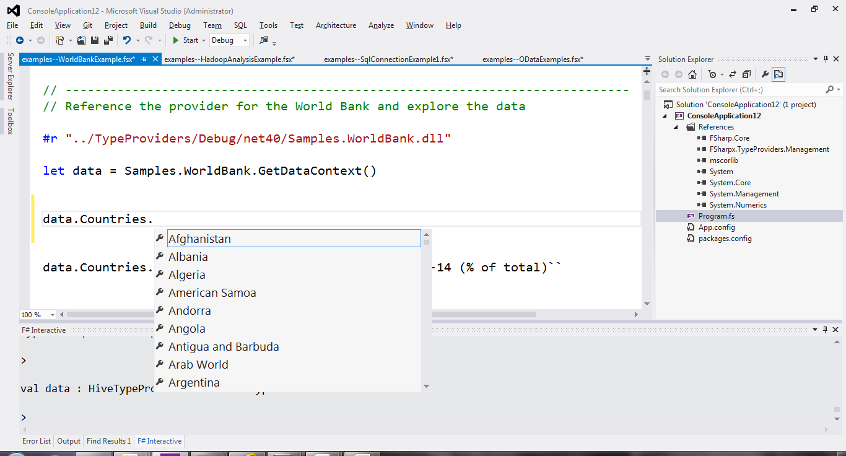
Web Data Sources

Slide 54
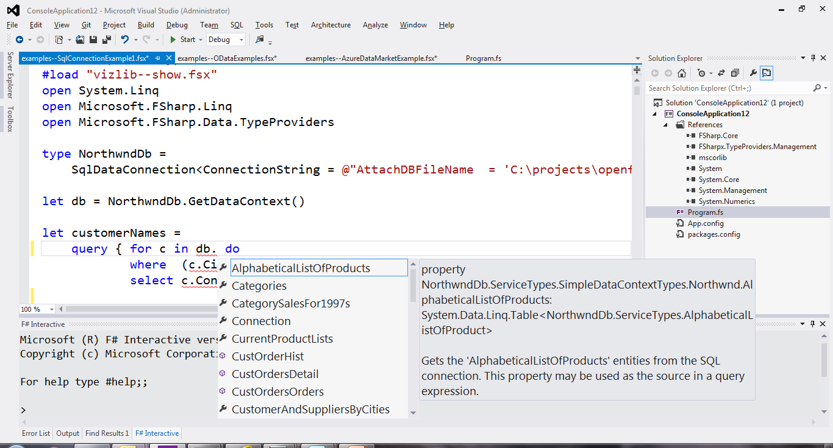
SQL

Slide 55
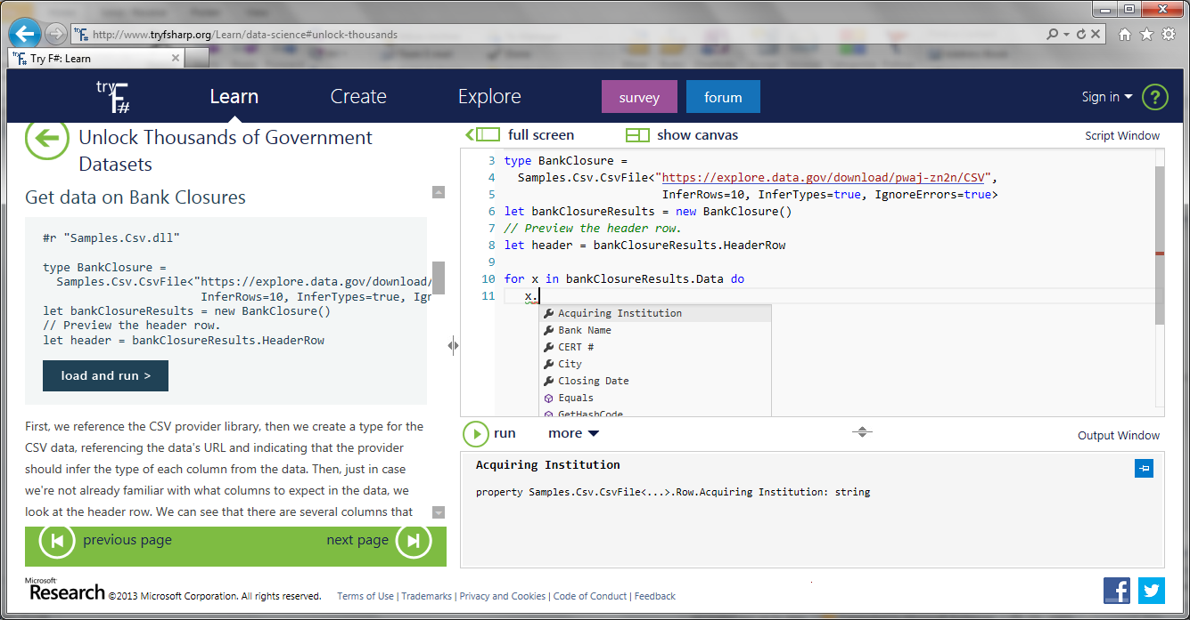
Types from Data (e.g. CSV)

Slide 56
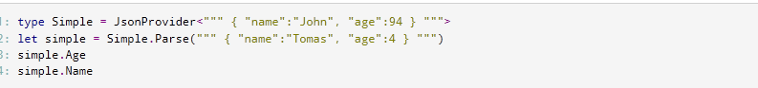
Types from Data (e.g. JSON)

Slide 57
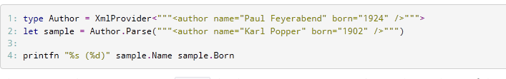
Types from Data (e.g. XML)

Slide 58
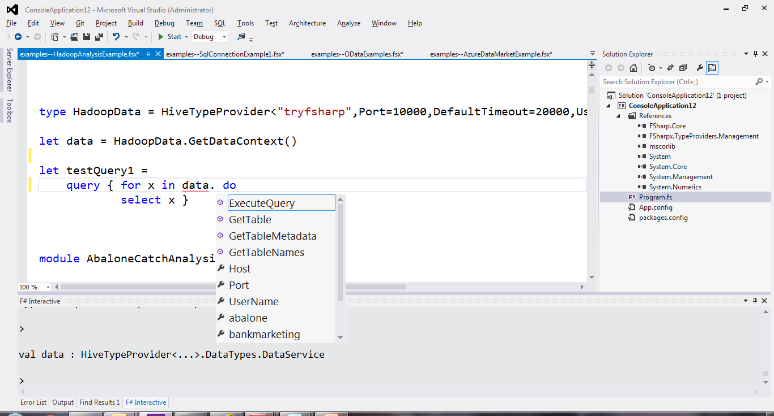
Scalable Data (e.g. Hadoop/Hive)

Slide 59
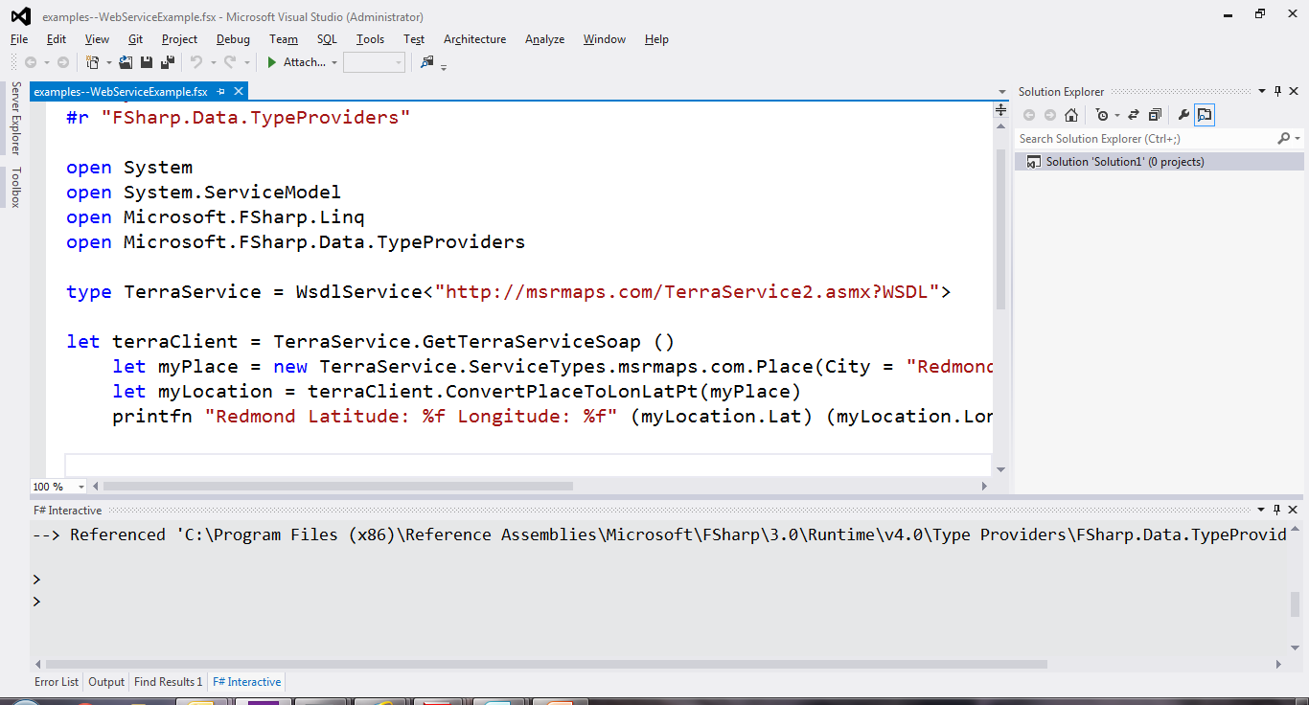
Service Protocols (e.g. WSDL)

Slide 60
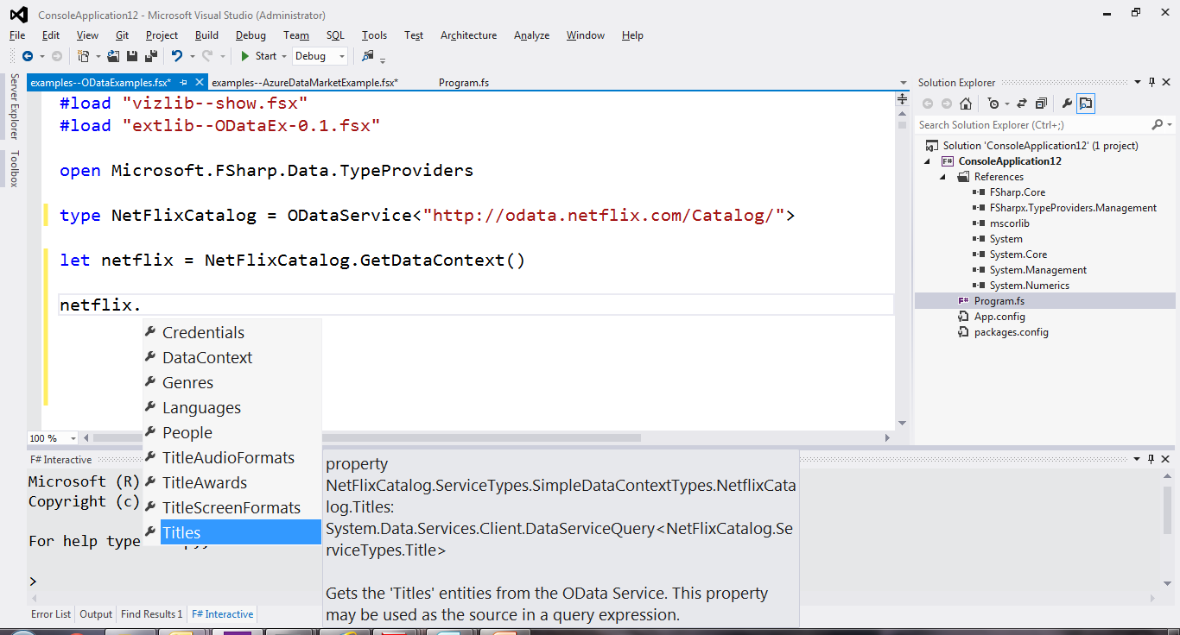
Service Protocols (e.g. Odata)

Slide 61
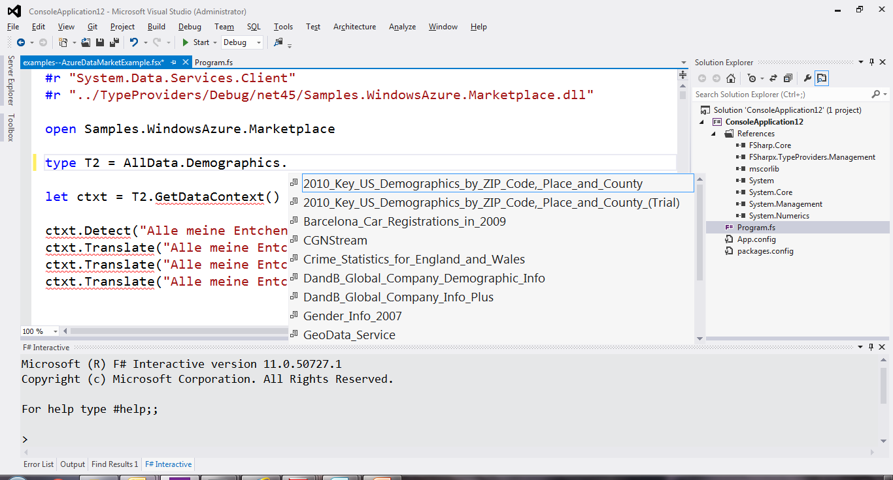
Data Markets (e.g. Azure Data Market)

Slide 62
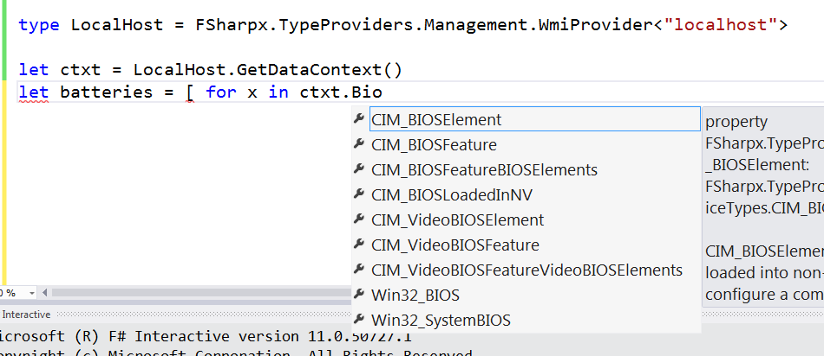
Systems Information (e.g. WMI)

Slide 63
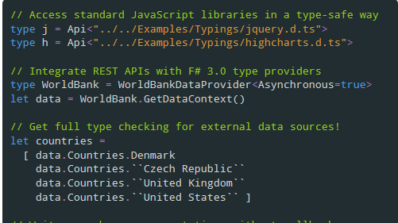
JavaScript/TypeScript

Slide 64
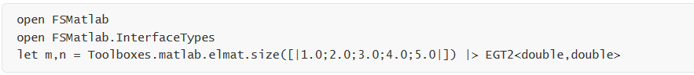
Matlab

Slide 65
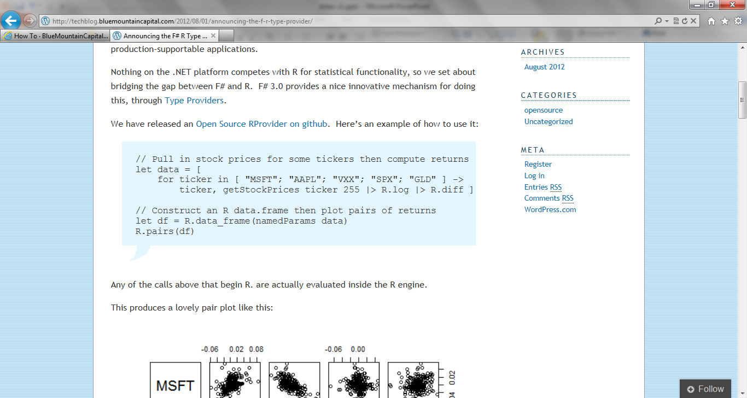
R

Slide 66
The FSharp.Data Library of Type Providers: fsharp.github.io/FSharp.Data

Slide 67
Relaxation Achieved (200%) F# Type Providers have been a staggeringly successful feature – their range of useful application is enormous. They bring data and typed programming into synthesis like no other feature around
Code
Data

Slide 68
X
Y
?

Slide 69
Pattern Matching
Abstraction

Slide 70
Sync
Async

Slide 71
Numbers
Numbers-with Units

Slide 72
GPU
CPU

Slide 73
What’s Ahead? Well, most major areas of tension have been resolved But there are still some areas that bug me...

Slide 74
REPL
Distribution and Scale
?
github.com/nessos/Vagrant

Slide 75
http://m-brace.net

Slide 76
In Conclusion
Resolving opposites is at the heart of applied language design
Opposites come in all shapes and flavours
F# finds new synthesis in areas crucial to the practical application of FP
Find your path!

Slide 77
Questions?

